Slide 1
CREDIT EDA CASE STUDY
BY AAYUSH MENDIRATTA

Slide 2
UNIVARIATE ANALYSIS
FOR ORIGINAL DATASET

Slide 3
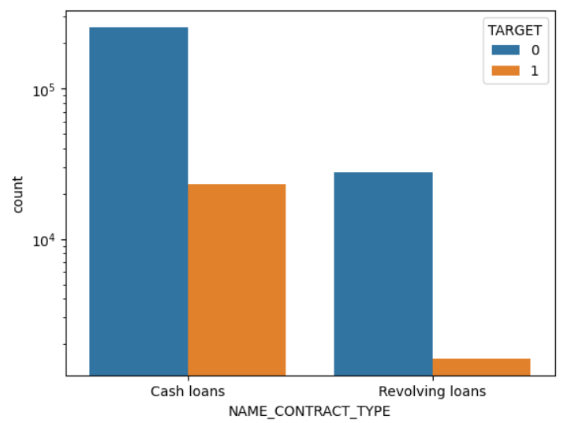
DISTRIBUTION FOR CONTRACT TYPE
‘Cash loans’ are high in number than ‘Revolving loans’.
By this graph 'Revolving loans' is small in amount compared to ‘Cash loans’

Slide 4
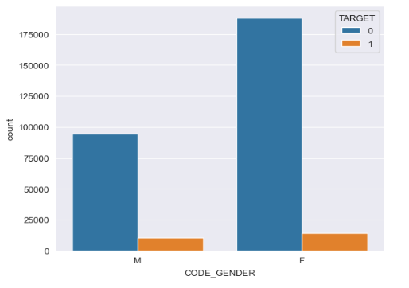
DISTRIBUTION FOR GENDER
The percentage of male defaulters are more than the female defaulters.

Slide 5
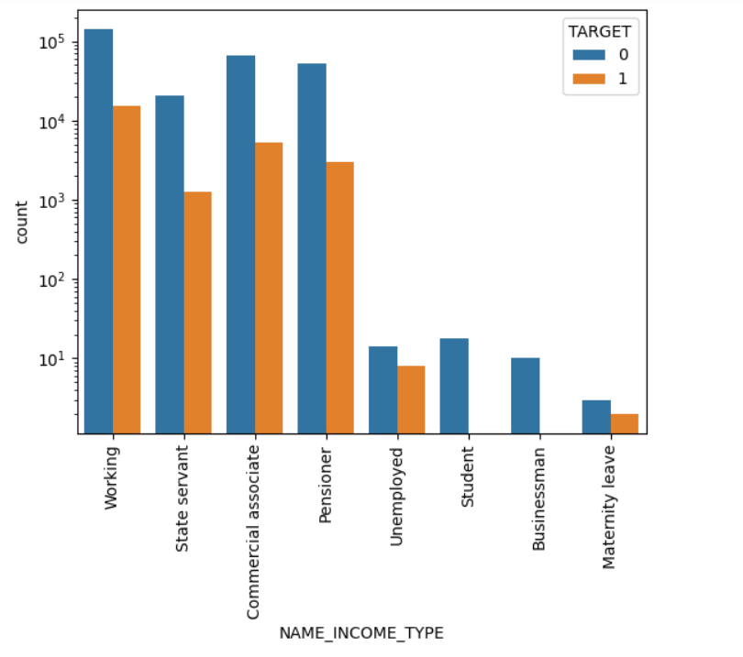
DISTRIBUTION OF INCOME TYPE
Student and business have higher percentage of loan repayment.
Working, State servant and Commercial associates are higher in default percentage.
Maternity category is significantly higher problem in repayment.

Slide 6
BIVARIATE ANALYSIS
FOR ORIGINAL DATASET

Slide 7
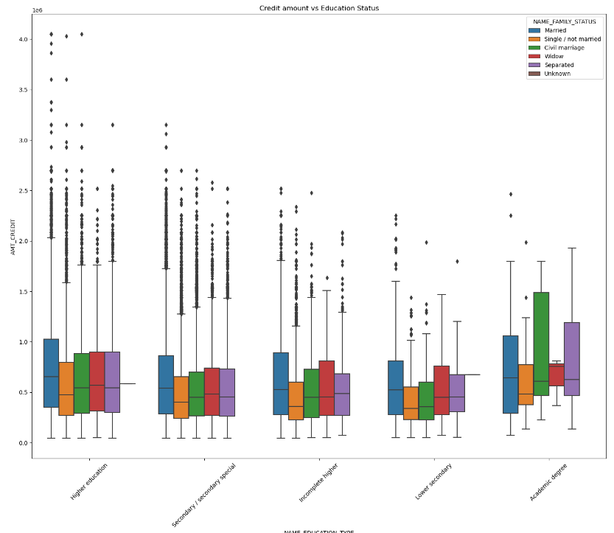
CREDIT AMOUNT vs EDUCATION STATUS
The Family status of 'Civil marriage', 'Married' and 'Separated' of Academic degree education are having higher number of credits than others.
Also, higher education of family status of 'Married', 'Single / not married' and 'Civil marriage' are having more outliers.
Civil marriage for Academic degree is having most of the credits in the third quartile.

Slide 8
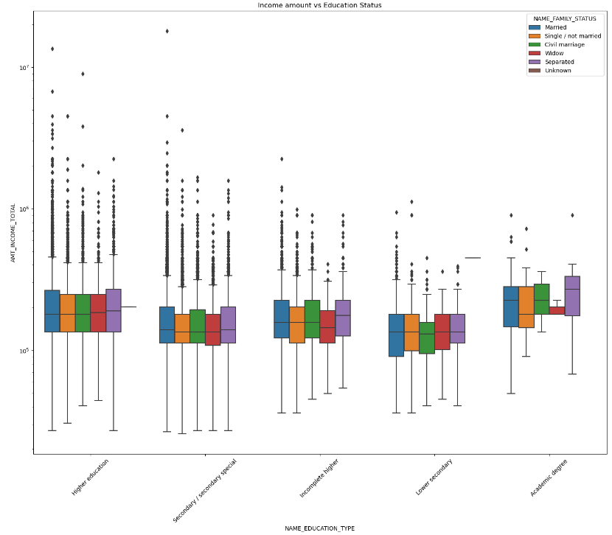
INCOME AMOUNT vs EDUCATION STATUS
Education type 'Higher education' have mostly equally income amount but have lots of outliers.
Academic degree have higher income amount than Higher education but they have less outliers.
Civil marriage in Lower secondary have less income than others.

Slide 9
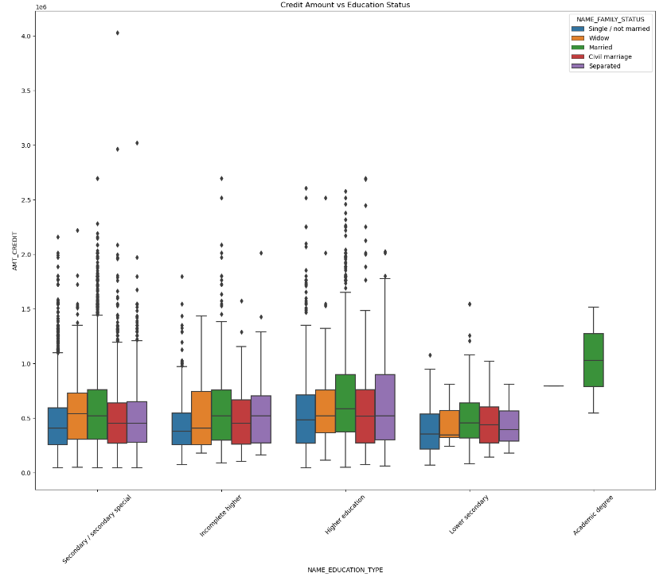
CREDIT AMOUNT vs EDUCATION STATUS
Married in Academic degree have highest income than others and don't have outliers and other status in Academic degree have almost nil income.
Secondary\ secondary special have lots of outliers.
Higher education have higher income than Secondary\ secondary special and also have less outliers.

Slide 10
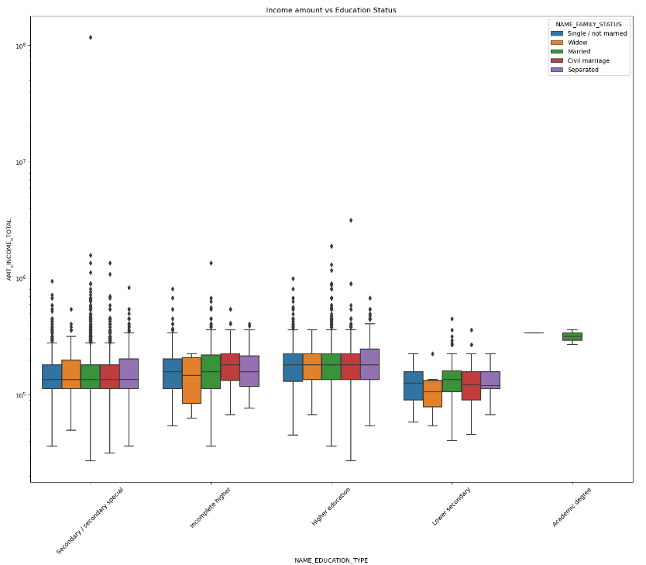
INCOME AMOUNT VS EDUCATION STATUS
Higher education have mostly equally income for different family status except Separated and have highest outliers.
Widow in Lower education have lowest income bracket.
Secondary\ secondary special also have mostly income for different family status except Separated and Widow and have almost same outliers as Higher education.

Slide 11
UNIVARIATE ANALYSIS
FOR NEW MERGE DATASET

Slide 12
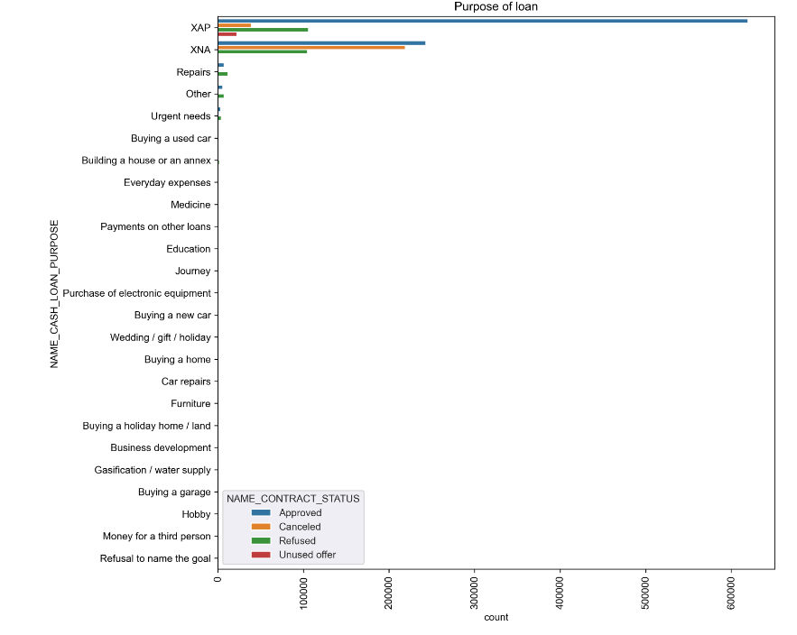
PURPOSE OF LOAN
Most of the loan that are rejected were from 'repairs'

Slide 13
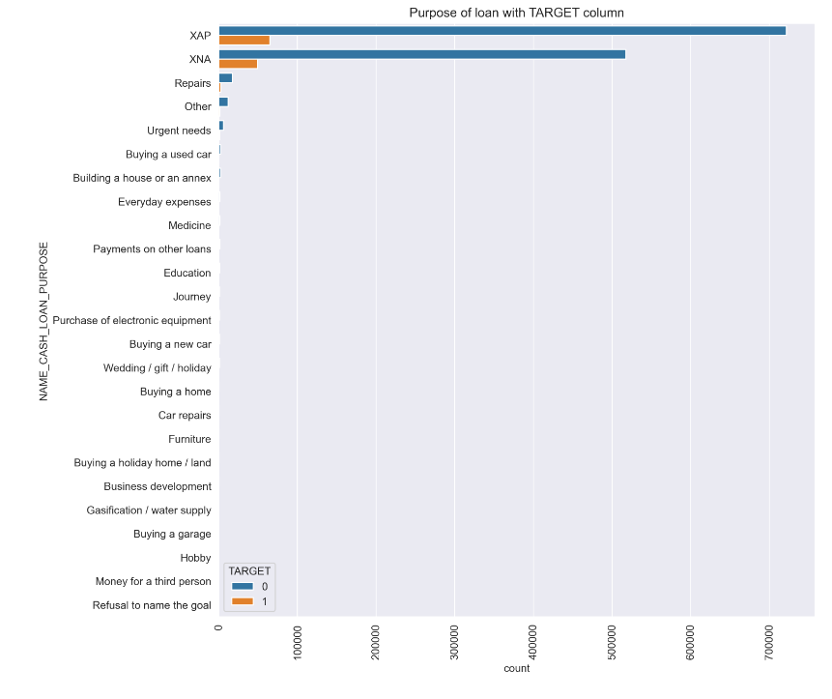
PURPOSE OF LOAN WITH TARGET COLUMN
Most of the loan that are rejected were from 'repairs'

Slide 14
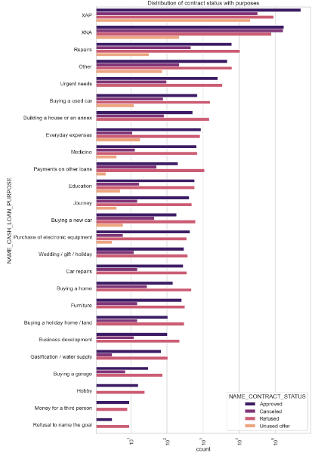
DISTRIBUTION CONTRACT STATUS WITH PURPOSES
Most rejection of loans came are from purpose 'repairs'.
For education purposes we have equal number of approves and rejection
Paying other loans and buying a new car is having significant higher rejection than approves.

Slide 15
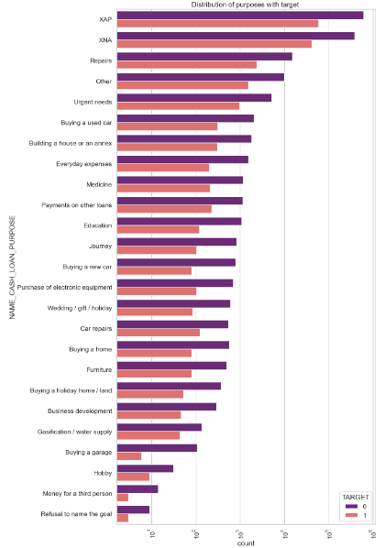
DISTRIBUTION PUPOSES WITH TARGET
Loan purposes with 'Repairs' are facing more difficulites in payment on time.
'Buying a garage', 'Business developemt', 'Buying land','Buying a new car' and 'Education' are facing higher difficulties in making loan payment.

Slide 16
BIVARIATE ANALYSIS
FOR NEW MERGE DATASET

Slide 17
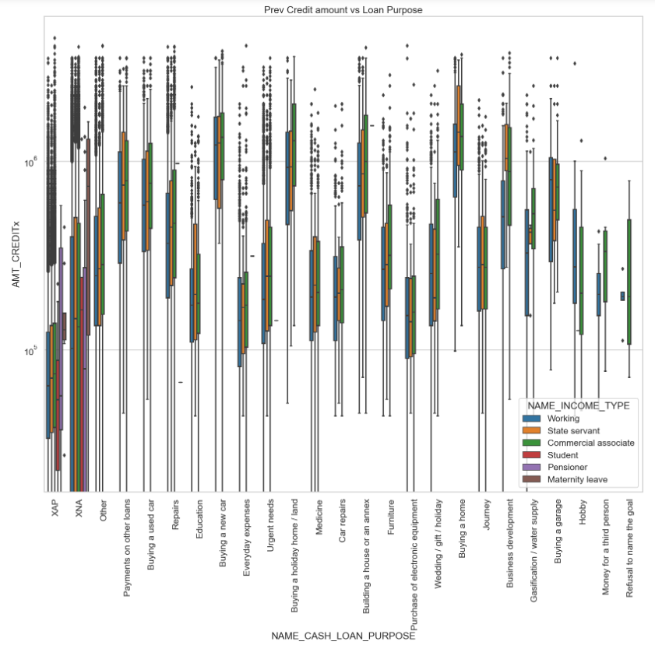
PREV CREDIT AMOUNT vs LOAN PURPOSE
The credit amount of Loan purposes like 'Buying a home','Buying a land','Buying a new car' and'Building a house' is higher.
Income type of state servants have a significant higher amount of credit applied.
Money for third person or a Hobby are having less credits applied for.

Slide 18
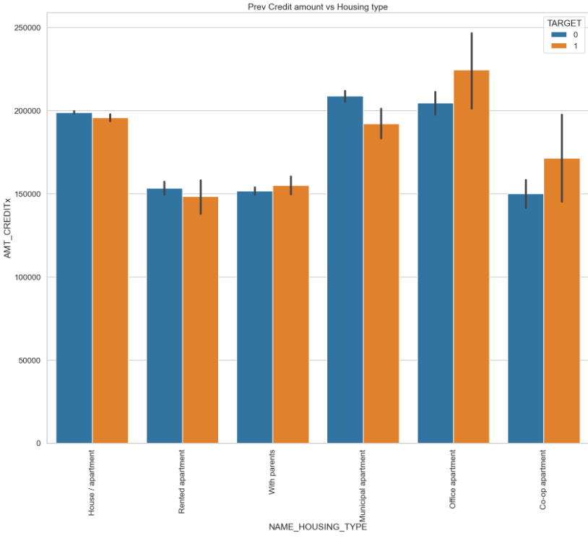
PREV CREDIT AMOUNT vs HOUSING TYPE
Office appartment are having higher credit of target 0 than target 1.
Co-op apartment is having higher credit of target 1 than target 0 and bank should not give loan to them.
Bank can focus mostly on housing type With parents or House\appartment or miuncipal appartment for successful payments.

Slide 19
CORRELATION FOR TARGET 0
HEATMAP

Slide 20
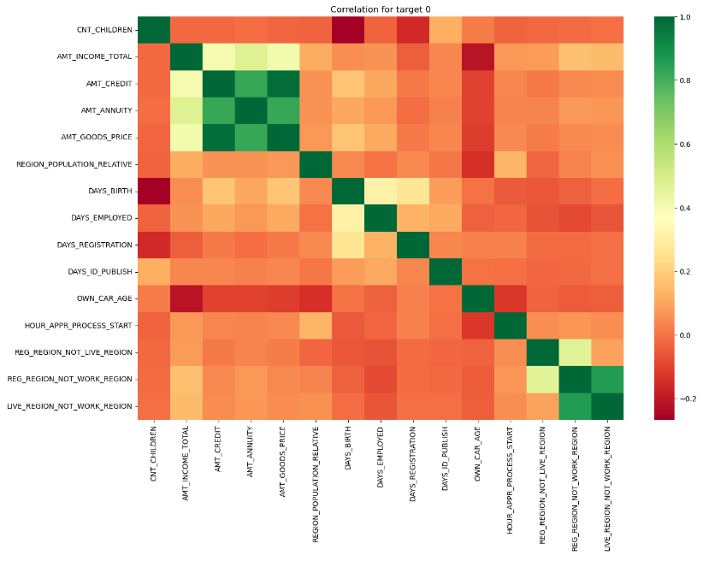
Credit amount is inversely proportional to the date of birth, which means Credit amount is higher for low age and vice-versa.
Credit amount is inversely proportional to the number of children client have, means Credit amount is higher for less children count client have and vice-versa.
Income amount is inversely proportional to the number of children client have, means more income for less children client have and vice-versa.
Less children client have in densely populated area.
Credit amount is higher to densely populated area.
The income is also higher in densely populated area.

Slide 21
CORRELATION FOR TARGET 1
HEATMAP

Slide 22
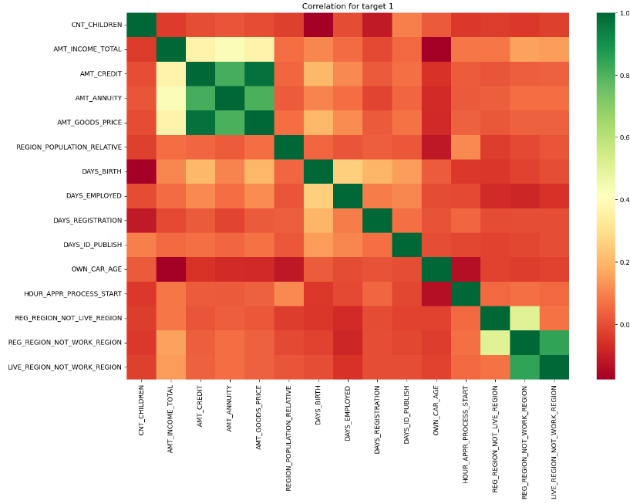
The client's permanent address does not match contact address are having less children and vice-versa
The client's permanent address does not match work address are having less children and vice-versa

Slide 23
CONCLUSION
Banks must target more on contract type ‘Student’ ,’Pensioner’ and ‘Businessman’ for profitable business.
Banks must focus less on income type ‘Working’ as it is has most number of unsuccessful payments.
Loan purpose ‘Repair’ are having higher number of unsuccessful payments on time.
Clients should be get from ‘With parents’ as they are having least number of unsuccessful payments.

